Slide 1
Para Professional Instructional Assistants
Cheryl Ramos
Muriel Clack
https://youtu.be/CcsUYu0PVxY

Slide 5
Kid President
https://youtu.be/RwlhUcSGqgs
Notes:
4 mins

Slide 7
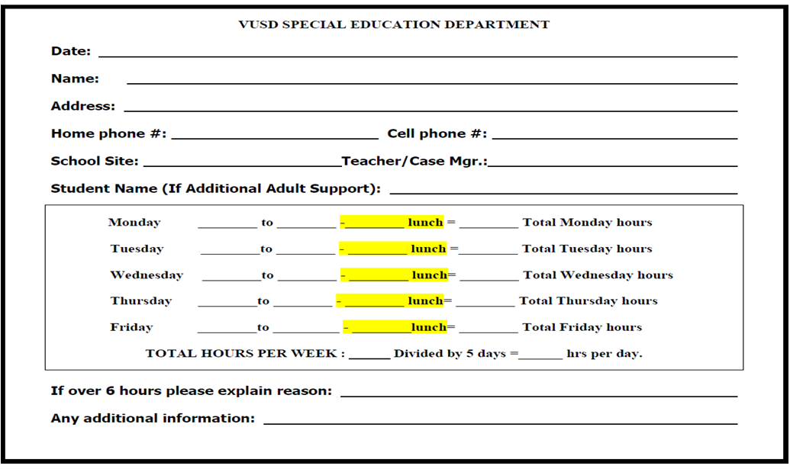
day to day schedule
Notes:
3 mins

Slide 8
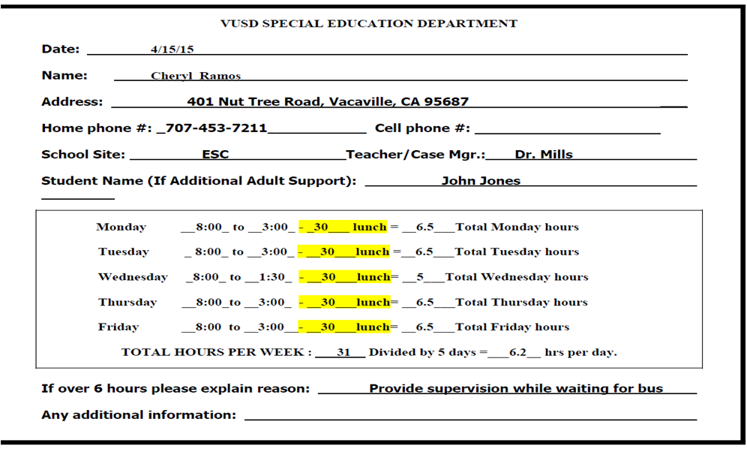
day to day schedule
Notes:
20 mins

Slide 9
Para Professional
Transition Specialist
Job Coach
Teacher Aide
Teacher's Assistant
educational assistant
Instructional Assistant
Special Education Assistant
classroom assistant
Para Educator
Bilingual Assistant
Who are we?
Behavior Assistant
Para Pro
Instructional Aide
Notes:
What is our name Who are Para educators? The National Resource Center for Paraprofessionals coined the term Para educator.

Slide 10
Handbook
Code of Ethics
Dress and Grooming
Confidentiality
First week on the job
Question for Clarity
Roles and responsibilities

Slide 11
Classified Personnel E 4219.21
CODE OF ETHICS
CLASSIFIED EMPLOYEES
School employees who are in daily contact with many phases of educational work should be persons whose conduct is beyond reproach and who sincerely believe in the advancement of education and the betterment of working conditions; therefore, the Service Employees International Union proposes this Code of Ethics as a standard for its members.
AS A SCHOOL EMPLOYEE I WILL:
1. Be proud of my vocation in order that I may use my best endeavors to elevate the standards of my position so that I may merit a reputation for high quality of service -to the end that others may emulate my example.
2. Be a person of integrity, clean speech, desirable personal habits, and physical fitness.
3 Be just in my criticism and be generous in my praise; to improve and not destroy.
4. At all times be courteous in my relations with students, parents, teachers and others.
5. Be a resourceful person who readily adapts himself to different kinds of work and changed conditions and
finds better ways to do things.
6. Conduct myself in a spirit of friendly helpfulness to my fellow employees to the end that I will consider no
personal success legitimate or ethical which is secured by taking unfair advantage of another.
7. Associate myself with employees of other districts for the purpose of discussing school problems and
cooperating in the improvement of public school conditions.
8. Always uphold my obligations as a citizen to my nation, my state, my school district
and my community, and give them unswerving loyalty.
9 Always bear in mind that the purpose of SEIU is to promote the efficiency and raise the standards of all
school employees and that I shall be equally obligated to assist all my fellow workers.

Slide 12
DRESS AND GROOMING 4319.22
The Board of Education believes that appropriate dress and grooming by district employees contribute to a productive learning environment and model positive behavior. During school hours and at school activities, employees shall maintain professional standards of dress and grooming that demonstrate their high regard for education, present an image consistent with their job responsibilities and assignment, and not endanger the health or safety of employees or students. All employees shall be held to the same standards unless their assignment provides for modified dress as approved by their supervisor.
Notes:
the thing we want you to walk away from this slide is not another policy or procedure to follow, but more of term of safety.
flat shoes in the event you need to follow a students
earrings that can't be pulled out.
rings that could scratch a student during an activity.

Slide 13
Confidentiality
Ongoing communication with parents is the responsibility of the IEP case Carrier and /or classroom teacher. However, there may be situations in which you are the person to whom parents initially communicate a need or question. Be sure to inform the teachers about the information discussed. If the teachers asks you to write in a student 's communication log, be sure to have the teacher review and approve each entry before sending it home.
California ED Code
45345. Notwithstanding the provisions of Section 48950, no instructional aide shall give out any personal information concerning any pupil who is not his own child or ward, except under judicial process, to any person other than a teacher or administrator in the school which the pupil attends. A violation of this section may be a cause for disciplinary action, including dismissal.
Notes:
Always refer the parent to the case manager or classroom teacher.

Slide 14
Role and Responsibility
Instructional
Duties the Para Professional may perform
Assist individuals or groups of students.
Listen to and read with students or small groups.
Provide support with independent reading.
Assist with practice activities and drill with teacher direction.
With teacher direction, create learning materials.
With teacher direction, modify learning materials.
Administer tests individually
Assist student with written activities
Assist student with organizational skills.
Check for class work and homework completion.
Assist with educational games
Assist students with technology skills.
Duties the Para Professional may not perform
Develop Lesson Plans
Develop tests for students
Take SOLE Responsibility for professional duties in the absence of the teacher.
Conduct formal assessments
Supply students with answers to assignments unless directed by the teacher.
Contact parents unless directed to do so by the teacher.

Slide 15
Behavioral
May
May not
Support teacher-directed behavioral modification plan for individual students.
Assist teacher with crisis intervention.
Monitor and assist student during seat work activities.
Report and record behavioral infractions to supervisor.
Physically restrain a student unless the student is A danger to self or others.
Corporal punishment is NOT allowed under any circumstance.
Other Duties
Supervise play activities.
Supervise hallway.
Supervise lunchroom.
Help maintain a clean, attractive and organized classroom
Provide specific personal care assistance with certain students.
Perform other out-of- class duties as directed by supervisor or administrator.
Assist with mobility.
Assume full responsibility for field trips.
Drive students in personal cars without proper authorization.
Discuss confidential student information within the school or community.
Call a parent to discuss a student, unless directed by the teacher or supervisor.

Slide 17
FAQ
?
Suggestions
Notes:
Who is your Supervisor--- Your direct supervisor is the Site Administrator, but you work under the Case Manager or Teacher
Alone in the classroom-
Cell Phone use

Slide 18
Vacaville Association Classified Employees
SEIU 1021
Vacavilleusd.org
Cheryl Ramos
Para Professional Instructional Assistants
Union Steward
453-7211
Notes:
5 min

