Slide 1
Positive Behavior Supports & Classroom Management
Jeremy Fowler – Behavior Specialist
Jennifer Alexis – Behavior Specialist
Sissy Keck - SDC Teacher
&
Derek Wickliff - Administrator

Slide 2
First Orders of Business
Questions from last time
Don’t forget the question box is still in the back of the room
You will be handed a time sheet as you leave. You may also choose to get Professional Growth. You may only choose one or the other. You only have the option of TS or PG if you are here beyond your normal duty day.
We ask that you take the time to fill out evaluations for the module when the module concludes. We want to deliver quality and necessary Professional Development that will be useful in the classroom.

Slide 3
Giving credit where credit is due…
The following information is modified from the BIP desk reference manual. The manual can be found at http://www.pent.ca.gov/dsk/bipmanual.html
The First Days of School. By Harry K. Wong

Slide 4
What is Classroom Management?
Behavior theorists support the following idea: Behaviors always occur within an environmental context and conditions within the environment may contribute, predict or “trigger” problem behaviors.
Classroom management is all about providing an environment that is predictable and routine so that you can move on with learning.
Without predictability and routine, the learning process can be disrupted.

Slide 5
Classroom Management Continued..
So what are the typical contexts/conditions analyzed when one wants to look at various aspects of the classroom that need to be managed:
Physical Setting
Social Setting
Instructional Strategies, curriculum and activities
Scheduling Factors
Degree of Independence
Degree of Participation
Social Interaction
Degree of Choice

Slide 6
What Classroom Management IS NOT…
Classroom discipline is a reactive strategy. It has a small place in its influence on overall classroom behavior. It is not considered a management tool.
Harry Wong is a good resource on Classroom Management versus Classroom Discipline.
According to Harry Wong, an effective teacher manages a classroom while an ineffective teacher disciplines the classroom.
We will talk about some discipline type strategies following the management strategies. However, discipline varies from school to school, so we will try to highlight for you some best practices.

Slide 7
A little bit of Harry “Live”
First Days of School

Slide 8
Let’s Take a Look at Your Role in a Well-Managed Classroom
The Characteristics of a well-managed classroom are:
Students are deeply involved with their work, especially with academic, teacher-led instruction.
Students know what is expected of them and are generally successful.
There is relatively little wasted time, confusion, or disruption.
The climate of the classroom is work-oriented but relaxed and pleasant.

Slide 9
High Level of Student Involvement With Work
There are four kinds of time at school: Allocated Time (the amount of time given to a student for learning), Instructional Time (the time you can observe a teacher teaching), Engaged Time (the time you can observe a student involved/engaged), and Academic Learning Time (the amount of time that the teacher can prove or demonstrate that the student has learned the content/mastered the skill.
Of the four kinds of time, only academic learning time has a direct correlation with achievement
The person who does the work is the ONLY one who learns
Research shows different types of tasks correlate to how much students retain

Slide 10
Top three Ways to Increase Student Involvement
Personalize lesson content to make material meaningful to the student.
Support students to gain success and produce results in getting things done. It is important for students to complete tasks and be rewarded for that. Students have a need to feel success. Don’t end with failure. When students are successful, they are more likely to return to the instructional setting.
Structure your work station, small group, etc., so that work and success can take place. Create a sense of security where students can work to produce results by making yourself and your environment predictable.

Slide 11
POP QUIZ!!!
Of the four kinds of time, only ________ _________ time has a direct correlation with achievement.

Slide 12
Clear Student Expectations
Objectives are what you want a student to accomplish, learn, comprehend, or master.
Objectives accomplish two things: 1. Assign –give direction/tell the students what is to be learned/mastered in a task; 2. Assess – tell the teacher if additional practice is needed to master an objective.
The students must know before a lesson, assignment, or activity begins what they are responsible for learning.
You must continually look at objectives to ensure goals and objectives align and students are on course.
Direct Instruction is key. When teachers explain exactly what students are expected to learn and demonstrate the steps needed to accomplish a particular task, students learn more.

Slide 13
Top Three Ways To Give Clear Expectations
Tell your students what they will be doing and why and demonstrate necessary steps.
Tie your lesson to a meaningful goal for your students
“Check off” with the student during the lesson when they have accomplished the lesson objectives

Slide 14
POP QUIZ!!!
Students must know _________ a lesson, assignment, or activity ________ what they are responsible for learning.

Slide 15
Relatively Little Wasted Time, Confusion, or Disruption
Have procedures and routines
Practice the procedures until they become routine
Start your lessons immediately, decrease down-time

Slide 16
Top Three Ways Build Procedures and Routines
Know your class and handpick the procedures/routines needed for success.
Model expectations or routine
PRACTICE!
Common procedures could include:
Ways to enter the classroom (note this will be demonstrated later)
Turning in work and what to do next
Independent time activities
Procedures for requesting help
What to do in common areas

Slide 17
More on Routines and Procedures
When introducing a routine or procedure, practice as frequently as possible.
Don’t worry about “wasting time,” research shows that if routines are in place then behaviors are less likely to occur and learning takes place.
Routines and procedures should be predictable and consistent.

Slide 18
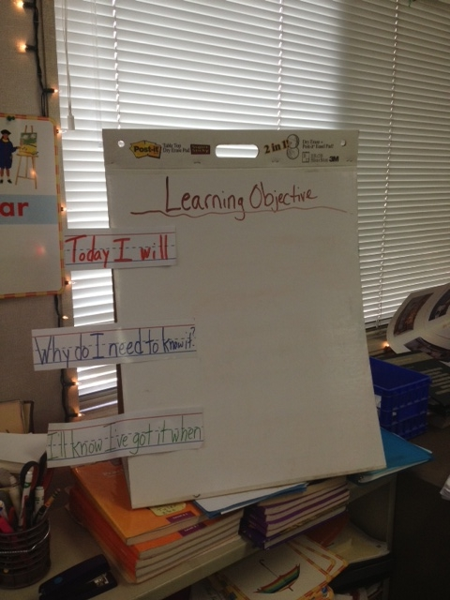

Slide 19
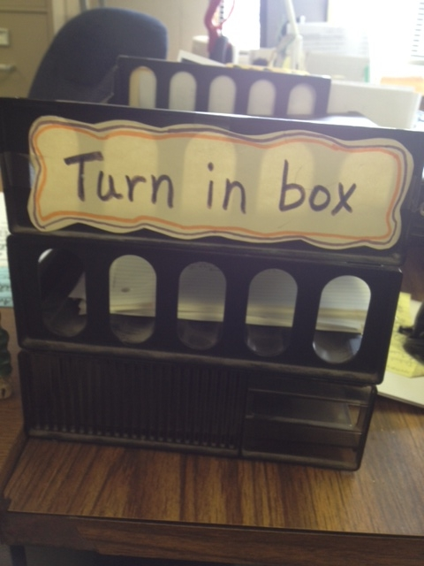

Slide 20
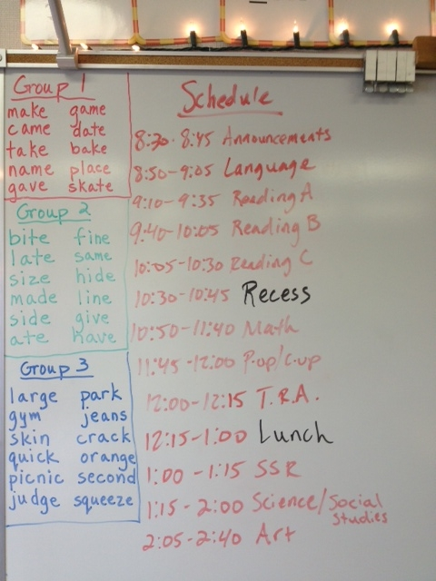

Slide 21
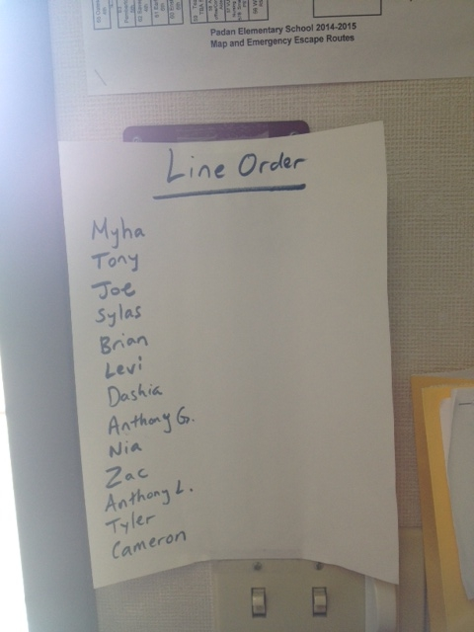

Slide 22
POP QUIZ
Practice ________ until they become __________.

Slide 23
Work-Oriented but Relaxed and Pleasant Climate
Know how to bring the class/group to attention
Know how to praise the deed and encourage the student.
Use positive language

Slide 24
Top Three Ways to Bring Your class to Attention:
Establish a procedure for the beginning of each teaching session. This procedure is one in which the students start the learning session, not the teacher.
Clearly post a quiet, busy task that the students can do with little or no teacher assistance.
Do your teacher busy work while the students are doing this task.
Seat your students in the same place every day.

Slide 25
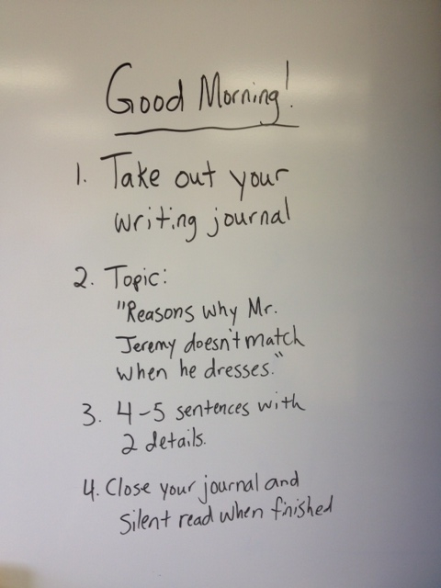

Slide 26
Top Three Ways to Praise the Deed and Encourage the Student:
Specifically tell the student what they have done correctly. It is not good enough to just say, “Good job.”
You have to praise and encourage positive behaviors so that they happen again. No encouragement means that you are not reinforcing the behavior=it may not happen again.
Use a wide variety of reinforcement. Reinforcer examples may include: physical (high five), verbal, activity access, tangible, tokens, and privileges.

Slide 27
Top Three Ways to be Positive
Do not stop teaching when a student does a disruptive behavior and you need to give out a consequence.
Have a procedure to give the penalty immediately and quietly (check on the board, moving the student’s color, etc)
Post your rewards for a job well done just as you would post any other procedure. Clearly label when/what the reward is.
Pay attention your body language and para verbal communication (voice tone, volume and cadence). Instead of telling the student what they did wrong, tell them the positive behavior you want from them.

Slide 28
What Classroom Management IS NOT - A revisit:
Classroom discipline is a reactive strategy. It has a small place in its influence on overall classroom management. It is not considered a management tool.
Harry Wong is a good resource on Classroom Management versus Classroom Discipline.
According to Harry Wong, an effective teacher manages a classroom while an ineffective teacher disciplines the classroom.

Slide 29
What is Discipline?
Discipline is the required action by a teacher toward a student (or group of students), after the student’s behavior disrupts the ongoing educational activity or breaks a pre-established rule created by the teacher, the school administration or the general society.
Notes:
Required? By law. No. What does the law say?
Required to get tasks done. Yes to maintain consistency: students may use the inconsistencies or omissions as an excuse for ignoring the rules. The “lawyer” in the student will come out if you are not clear and consistent. What if the sign on the highway said “Don’t speed” rather than a specified limit. Would you argue with the officer?
Toward a student (or a group of students?): No, toward a behavior. Be clear you are focusing on the behavior, not the student.
Pre-established? Yes, you need a simple, common language for discipline to be effective and it needs to be understood and pre-established.
Created…Not really. Teacher or teacher in conjunction with students create classroom rules, admin sets school (hallway, cafeteria, etc.) rules.

Slide 30
The “When’s” of Discipline
The Day before the…
First Day of School
The 17th day of school
It Depends
Immediately
Delayed
Notes:
The day before…Discipline, like management, needs to have a plan and each player needs to understand their role. The day before school begins might be the time the team meets to go over the discipline plan.
The first day of school: Teacher either introduces the plan or works with students to create the plan: rules and consequences.
17th day of school: Random date early, but the rules/consequences are discussed throughout the year as positives (you have done a great job with rule 3…or…this week we are going to focus on rule 4…or…who can tell me rule 1 without looking?)
It Depends…
Immediately vs. Delayed. Don’t embarrass the student. Can the student recall their actions if you wait 5 minutes to get them alone? What other factors might play into this? Time of day?

Slide 31
The “Who’s” of Discipline
Student
Staff
Admin
Parent
Notes:
Student: Does the student understand the reason for the discipline and the consequences given. Simple is better.
Other students involved? Never, never, never.
Staff (teacher will work in conjunction with admin to set this up): Para role. Early steps of the discipline plan. Usually, once it hits the level of outside involvedment-see below-then the teacher will probably take over. Calm, matter of fact, even as discipline is happening, focusing on the plan for improvement.
Admin: At what level, in what capacity. Different for each teacher/site/admin.
Parent: The epitome of the “It depends” statement. Teacher/admin will make this determination.

Slide 32
Discipline Wrap-up
What/Why
When
Who
Where
How
Notes:
A wrapup and where to go from here:
Why? Why do we need laws and rules? Behavioral expectations in order to create a safe, productive environment for all.
When? Early, always, and it depends.
Who? EVERYONE possible.
Where? Didn’t talk about this, but EVERYWHERE.
How? Clear. Simple. Easily understood. Don’t let the student interpret the problem/solution, simplify it for them or the lawyer in them.

Slide 33
Thank you!!!
The next development is….
ELIGIBILITY AREAS AND USING ASSESSMENT TO DETERMINE NEEDS TO CREATE GOALS AND CHARACTERISTICS OF A STUDENT WITH SPECIAL NEEDS
WHEN: Wednesday, March 25th, 2:30-3:30pm WHERE: Vaca Pena MP Room

