Slide 1
Special Education Process
And
Eligibility Categories

Slide 2
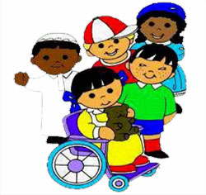
Special Education Process
Assessment
Need
Goals
Services
Placement

Slide 3
Assessment
Intelligence, Cognitive Functioning, Thinking and Learning Ability
Psychological Processing: visual-motor, phonological or other processing areas
Academic Achievement
Social/Emotional/Behavioral
Autism

Slide 4
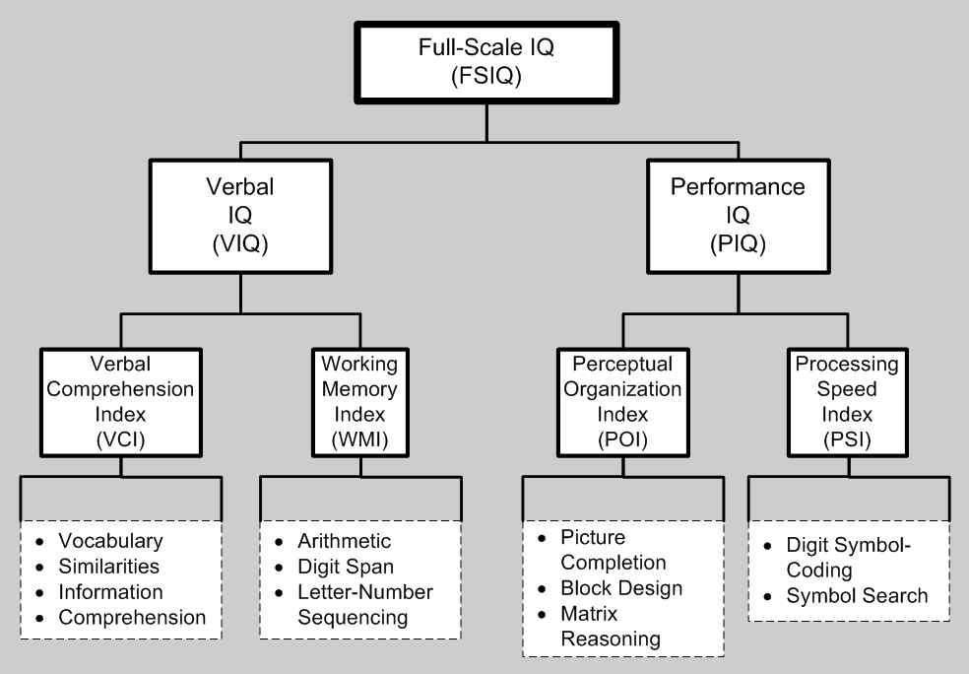
Intelligence, Cognitive Functioning, Thinking and Learning Ability
To identify ability and/or disability such as intellectual disability

Slide 5
Psychological Processing to Identify Specific Learning Disability
Visual-Motor Integration
Motor Coordination
Visual Perception

Slide 6
Phonological Processing
Phonological Awareness- identify and access the basic sounds of language
Phonological Memory- remembering the sounds of the language that is heard
Rapid Naming- finding language sound information that has been previously learned
Reading Skills

Slide 7
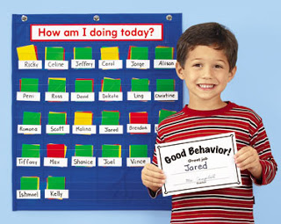
Social, Emotional, Behavioral
Social Skills
Emotional Disturbance
Behavior Problems

Slide 8
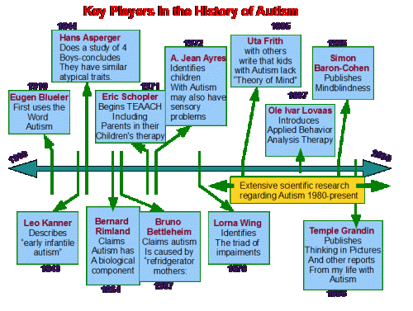
Autism

Slide 9
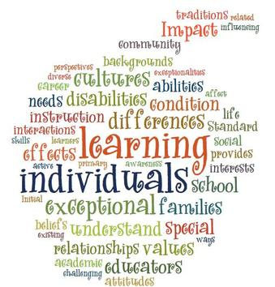
Special Education Eligibility Categories What are they????

Slide 10
Special Education Eligibility Categories
Specific Learning Disability
Speech/Language Impairment
Emotional Disturbance
Intellectual Disability
Other Health Impairment
Autism
Deaf-Blindness
Deafness
Hearing Impairment
Multiple Disabilities
Orthopedic Impairment
Traumatic Brain Injury

Slide 11
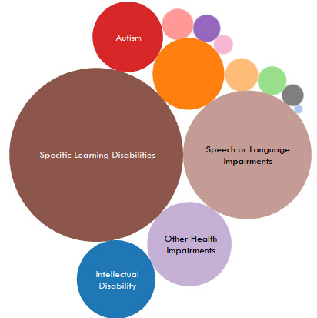
Special Education Eligibility

Slide 12
Special Education Eligibility Category | Number of VUSD Students in this category | Percent of VUSD special education students identified eligibility on IEPs
1. Specific Learning Disability | 509 | 37%
2. Speech/Language Impairment | 342 | 25%
3. Other Health Impairment | 181 | 13%
4. Autism | 175 | 13%
5. Emotional Disturbance | 97 | 7%
6. Intellectual Disability | 33 | 2%
7. Hearing Impairment | 17 | 1%
8. Orthopedic Impairment | 12 | 0.8%
9. Visual Impairment | 10 | 0.7%
10.Traumatic Brain Injury | 1 | 0.07%
11. Deafness | 1 | 0.07%
12. Deaf-Blindness | 0 | 0
13. Multiple Disabilities | 0 | 0
Total VUSD SpEd Students on Dec 2015 State Report | 1378 | 100%

Slide 13
Specific Learning Disability
Must have psychological processing deficit in: visual/motor, phonological processing (score at or below 10%tile) or other area of processing
Must have significant discrepancy (19 points) between ability (IQ) and academic achievement

Slide 14
Speech/Language Impairment
A child may exhibit difficulties with:
Fluency-stuttering
Articulation-speech sounds
Language delay (scores at or below 7th %tile)- understanding and use of language including grammar, syntax, morphology, semantics or pragmatics.

Slide 15
Intellectual Disability
IQ below standard score of 70
Adaptive behavior score below 70

Slide 16
Autism
May or may not have medical diagnosis of autism
District must evaluate to identify characteristics of autism
Special Education Eligibility criteria for autism is much less stringent than DSM-5 medical diagnostic criteria

Slide 17
Emotional Disturbance (ED)
District must evaluate for evidence of ED
Child may or may not have a medical diagnosis
ED is different from social maladjustment: oppositional defiance disorder or conduct disorder (these are said to be under control of the individual while ED and resulting behaviors are not)

Slide 18
Other Health Impairment
means having limited strength, vitality, or alertness, including a heightened alertness to environmental stimuli, that results in limited alertness with respect to the educational environment that:
Is due to chronic or acute health problems such as asthma, attention deficit disorder or attention deficit hyperactivity disorder, diabetes, epilepsy, a heart condition, hemophilia, lead poisoning, leukemia, nephritis, rheumatic fever, sickle cell anemia, and Tourette syndrome;
(B) Adversely affects a child's educational performance.

Slide 19
Traumatic Brain Injury
Traumatic brain injury means an acquired injury to the brain caused by an external physical force, resulting in total or partial functional disability or psychosocial impairment, or both, that adversely affects a child's educational performance. Traumatic brain injury applies to open or closed head injuries resulting in impairments in one or more areas, such as cognition; language; memory; attention; reasoning; abstract thinking; judgment; problem-solving; sensory, perceptual, and motor abilities; psychosocial behavior; physical functions; information processing; and speech.
Traumatic brain injury does not apply to brain injuries that are congenital or degenerative, or to brain injuries induced by birth trauma.

Slide 20
Visual Impairment
Visual impairment including blindness means an impairment in vision that, even with correction, adversely affects a child‘s educational performance. The term includes both partial sight and blindness.

Slide 21
Deaf-Blindness
Deaf-blindness means concomitant hearing and visual impairments, the combination of which causes such severe communication and
other developmental and educational needs that they cannot be accommodated in special education programs solely for children with
deafness or children with blindness.

Slide 22
Deafness
Deafness means a hearing impairment that is so severe that the child is impaired in processing linguistic information through hearing, with or without amplification that adversely affects a child's educational performance.

Slide 23
Hearing Impairment
Hearing impairment means an impairment in hearing, whether permanent or fluctuating, that adversely affects a child's educational performance but that is not included under the definition of deafness in this section.

Slide 24
Multiple Disabilities
Multiple disabilities means concomitant impairments, such as intellectual disability-blindness or intellectual disability-orthopedic impairment, the combination of which causes such severe educational needs that they cannot be accommodated in special education programs solely for one of the impairments. “Multiple disabilities” does not include deaf-blindness.

Slide 25
Orthopedic Impairment
Orthopedic impairment means a severe orthopedic impairment that adversely affects a child's educational performance. The term includes impairments caused by a congenital anomaly, impairments caused by disease (e.g., poliomyelitis, bone tuberculosis), and impairments from other causes (e.g., cerebral palsy, amputations, and fractures or burns that cause contractures).

Slide 26
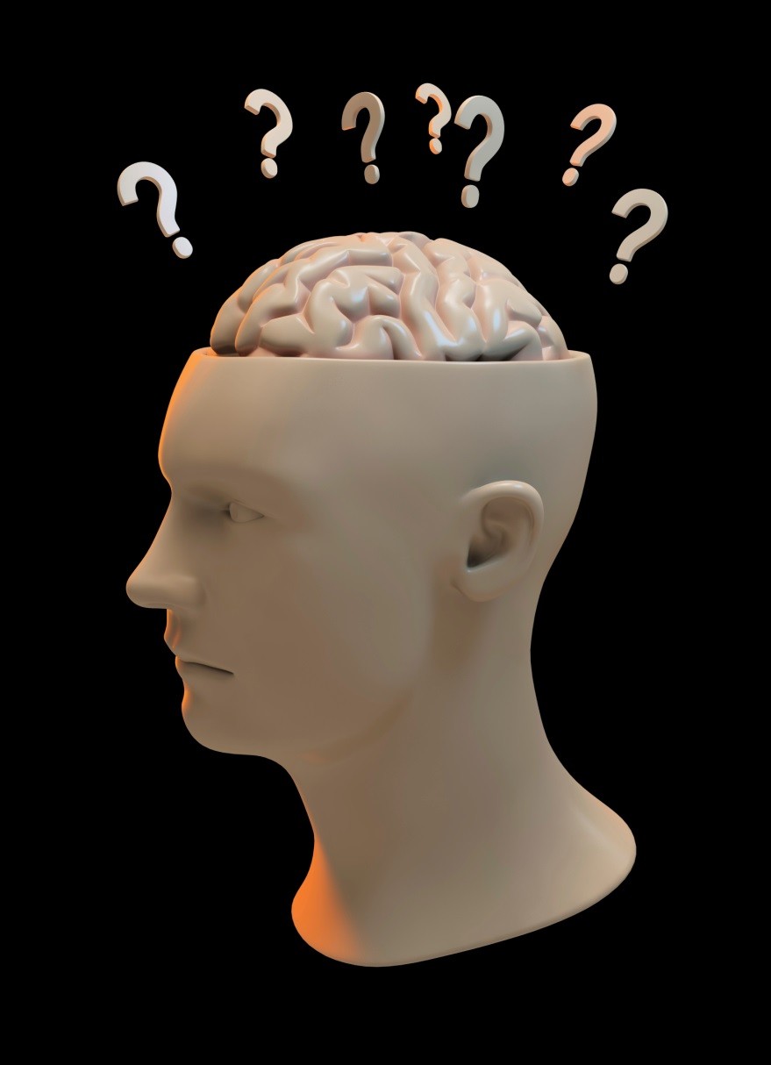
What are the special education eligibility categories?

Slide 27
Now let’s take the post test
Please write down all the special education eligibility categories

Slide 28
Top 6 Eligibility Categories:
1. Specific Learning Disability
2. Speech/Language Impairment
3. Other Health Impairment
4. Autism
5. Emotional Disturbance
6. Intellectual Disability

Slide 29
Other 7 Categories
7. Hearing Impairment
8. Orthopedic Impairment
9. Visual Impairment
10. Traumatic Brain Injury
11. Deafness
12. Deaf-Blindness
13. Multiple Disabilities

